Slide 1
My first figure with toPPT-beta1, Example 1-2
Example toPPT() 2.1 by Jens Richter

Slide 2
Example 3a - Adding a figure at a certain position

Slide 3
Example 3b - Defining the height and width of a figure in percentage

Slide 4
Example 3b - Defining the height and width of a figure in pixel

Slide 5
Example 3c - Adding a figure at a certain position by specifying position in pixel or percentage

Slide 6
Example 3c - Adding a figure at a certain position by specifying position in pixel or percentage

Slide 7
Example 3d - Adding an existing figure

Slide 8
Example 3d-2 - Adding an existing image

Slide 9
Example 5d - Inserting content in a new slide at slide number 4 (will shift all following slides)
New inserted Text AFTER slide Number 8

Slide 10
Example 8a - Changing the padding/gap of the active placing area of the slide

Slide 11
Example 8b - Change the dividing of the slide

Slide 12
Example 4 - Adding a text with a bullet point
My first bullet item

Slide 13
Example 4a - Adding a text with a bullet point to a new slide
Text1
Text2
Text3

Slide 14
Example 4b - Adding multiple texts with a bullet point to a new slide
Text1
Text2
Text3
Text1
Text2
Text3

Slide 15
Example 4c - Applying bold, underlined and italic to text elements (css-tags)
Bold
Bold and underlined meets Italic
Normal

Slide 16
Example 4d - Changing the color, size and font of text elements (css-tags)
Red text, Black text, Blue text
Using Times New Roman
BIG

Slide 17
Example 4e - Changing color, size and font and apply bold, underlined and italic
Mixed One
Bold, underlined,italic and Times
Draw a frame around me

Slide 18
Example 4eb - Inserting content after an existing slide identified by its title
New inserted Text after Slide of Example 4e

Slide 19
Example 4f - Using Hex-Code for defining the color of a text element
CadetBlue meets LightSalmon
New updated Text on slide "Example 4f"
New updated Text on slide "Example 4f" with wrong spelling of title

Slide 20
Example 4 η - Using TeX in texts
Lets start with something easy x = √x²
I like red formulas x = √x²
And big blue ones x = √x²

Slide 21
Example 4 γ - Using TeX and css-tags in texts at the same time
Colored formula with Tex: a²+b² = c²
TeX color is overwritten by "normal" tag: a²+b² = c²

Slide 22
Example 4 φ - Using TeX in texts together with matlab build in texlabel-function
λ₁₂^{3/2}/π - π δ^{2/3}
H(x) ψ(x)=E ψ(x)
TeX Interpreter is off:
{H}({x}) {\psi}({x})={E} {\psi}({x})

Slide 23
Example 5a - Updating an existing slide identified by its title
Check "Example 4f" for updated texts.

Slide 24
Example 5b - Inserting content after an existing slide identified by its title
Check slide after "Example 4e" for inserted text.

Slide 25
Example 5c - Updating an existing slide identified by its slide number
Check first slide for updated text.

Slide 26
Example 5d - Inserting content in a new slide after slide number 8 (will shift all following slides)
Check slide after slide 8 for inserted slide 9.

Slide 27
Example 6 - Adding Sections
Add a section for the basic commands!
Add a section for texts and tags.
Add a section for updating and inserting slides.
Add a section for Special commands.

Slide 28
Example 7 - Applying a template to the active presentation
We applied a template!

Slide 29
Example 8a - Adding tables using cell of strings (right table is using auto rotate)
Caption1 | Caption2 | Caption3
Me is first | Me is second | Me is formula: H(x) ψ(x)=E ψ(x)
Me is fourth | Me is fifth | Me is sixth
Caption1 | Caption2
Me is first | Me is fourth
Me is second | Me is fifth
Me is formula: H(x) ψ(x)=E ψ(x) | Me is sixth

Slide 30
Example 5b - Adding tables using vectors and cells mixed (right table is using auto rotate)
Col 1 | Col 2 | Col 3
1 | 2 | 3
Me is 1 | Me is 2 | Me is 3
Col 1 | Col 2
1 | Me is 1
2 | Me is 2
3 | Me is 3

Slide 31
Example 5c - Adding tables using a matrix
Col 1 | Col 2
1 | 1
1 | 1
1 | 1
Col 1 | Col 2
1 | 1
1 | 1

Slide 32
Example 9 - Deactivating toPPT temporally and reactivating

Slide 33
Example 10 - Adding comments
Some text 1
Some text2

Slide 34
Example 11 - Using commandChains
Caption1 | Caption2 | Caption3
Me is first | Me is second | Me is formula: H(x) ψ(x)=E ψ(x)
Me is fourth | Me is fifth | Me is sixth

Slide 35
Example 12 - Change format and orientation of presentation
Changing the page orientation is done e.g by toPPT('setPageOrientation','landscape');
Changing the page orientation is done e.g by toPPT('setPageFormat','16:9');

Slide 36
Example 13 - Change the resolution of the figure for exporting (high resolution)

Slide 37
Example 13 - Change the resolution of the figure for exporting (low resolution)

Slide 38
Example 14 - Export figure as vector graphic
My Figure for toPPT
1
one
0.8
two
three
0.6
0.4
0.2
y
0
-0.2
-0.4
-0.6
-0.8
-1
0
1
2
3
4
5
6
7
x

Slide 39
Example 14a - Export figure via matlab build in functions

Slide 40
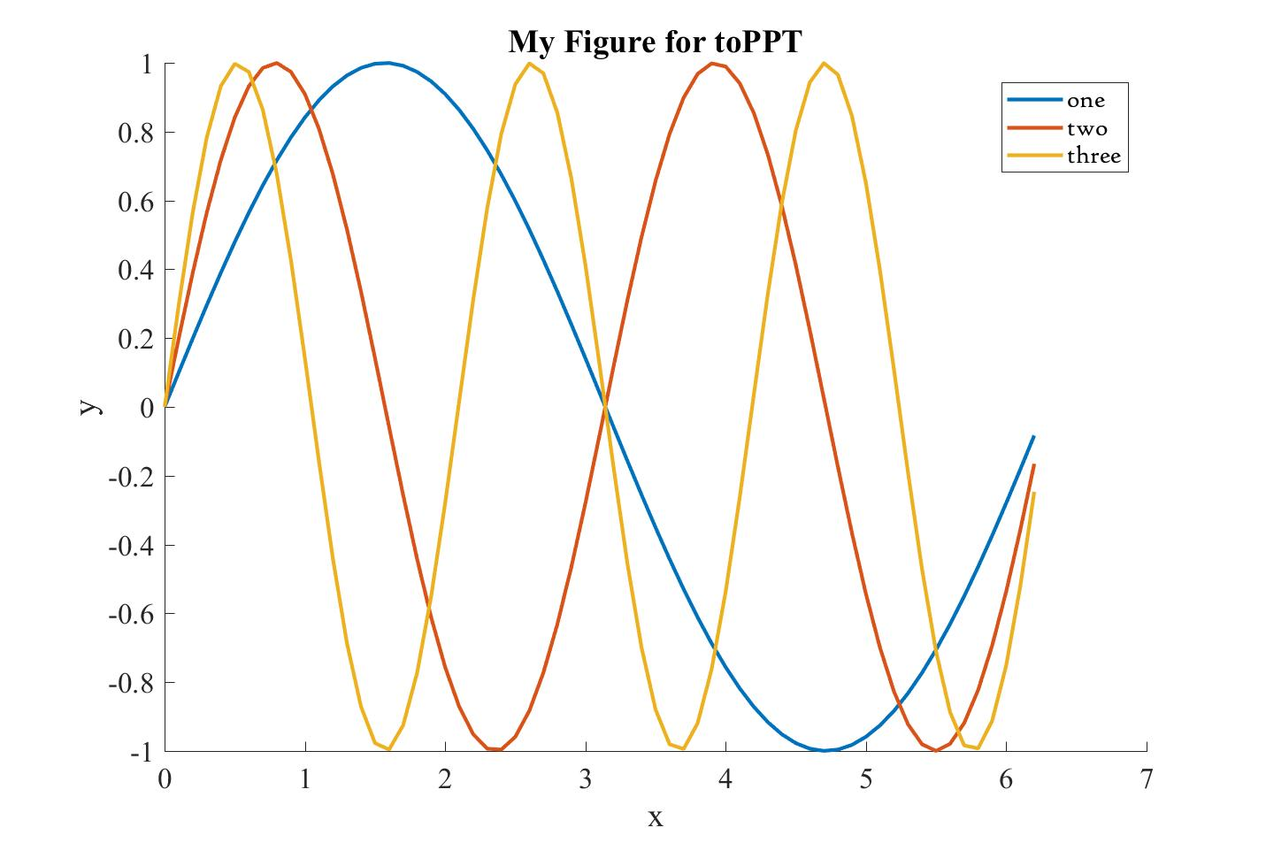
Example 14b - Export figure via matlab build in functions by specifing format type

Slide 41
Example 15 - Change the colorspace (specify parameters for exportfig directly via toPPT)

Slide 42
Example 16a - QR-Code with test message "Hello world"

Slide 43
Example 16b - Adding MECard as QR Code
Thank you for your attention.
Please scan the QR Code for Luke Skywalkers contact information.

Slide 44
Example 16c - Syntax for downloading the necessary jars from the internet
Downloading jars for QR-Code generator is done by toPPT(someStringMessage,'QR-DownloadJars',1)

